Slide 1
GSA’s Vendor and Customer Self Service (VCSS)
Notes:
Hello and welcome to GSA’s Vendor and Customer Self Service (VCSS) training course. This course has been developed to walk you through the navigation and functionality of VCSS. You are listening to Segment 1, Introduction

Slide 2
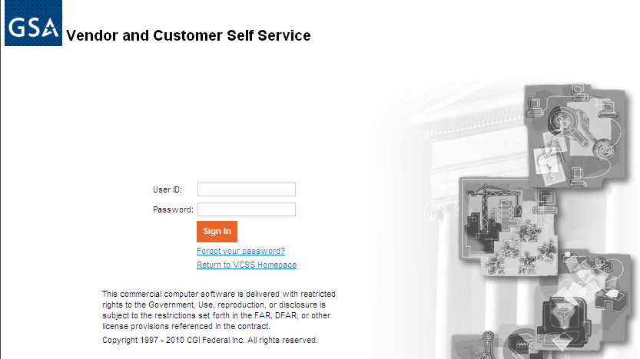
Login to VCSS
To login to VCSS, perform the following steps:
Go to the GSA launch page (http://vcss.gsa.gov) and select the Login to VCSS option.
On the VCSS main page, select the Login hyperlink.
On the VCSS login page, enter your login information:
User ID and Password sent in two separate emails from GSA.
Select the [Sign In] button.
C1
Notes:
You can login to VCSS via the GSA launch page.

Slide 3
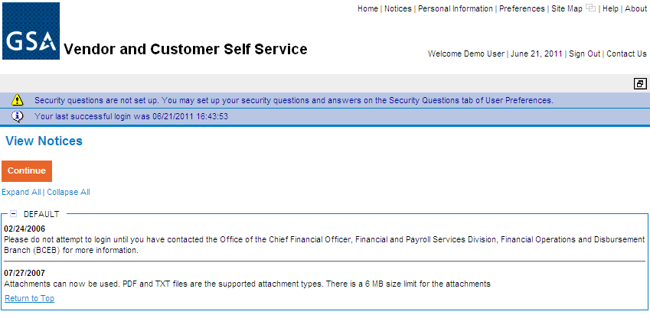
View Notices
Upon successful login, the View Notices page displays.
Notices provide specific information, for example, notifying the customer when billings become available.
Review notices associated with your accounts and then select the [Continue] button.
C2

Slide 4
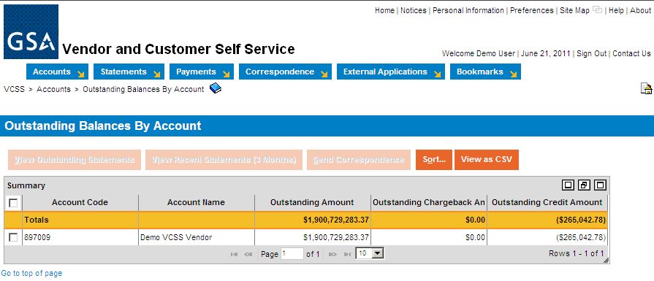
Home Page
After reviewing notices, the home page displays.
View your outstanding balances by account.
Access the two navigation menus that appear on most VCSS pages:
The link strip, which is a set of clickable hyperlinks, located in the top right corner of the page.
The menu bar, which is a horizontal row of menus, with each menu item containing a drop-down menu of additional options.
Link Strip
Menu Bar
C3
Notes:
Although the screenshot only shows a single account on the Outstanding Balances by Account page, multiple accounts could be displayed if the user has access to multiple accounts.

Slide 5
Link Strip
The link strip contains several hyperlinks to access other areas of VCSS.
The hyperlinks include:
Home
Notices
Personal Information
Preferences
Site Map
New Window Icon
Help
About
Sign Out
Contact Us
C4
Notes:
Here is a list of the link strip hyperlinks to other areas in VCSS. We are now going to walk through each of these links and what they are used for.

Slide 6
Link Strip (Cont’d)
Home hyperlink
Select the Home hyperlink to return to the home page.
The home page is the same page that displays after you sign in to VCSS and view your notices. The home page also lists your outstanding balances by account.
C5
Notes:
In the link strip, select the Home hyperlink.

Slide 7
Link Strip (Cont’d)
Notices hyperlink
Select the Notices hyperlink to return to the View Notices page.
The View Notices page is the same page that displays after you sign in to VCSS.
C6

Slide 8
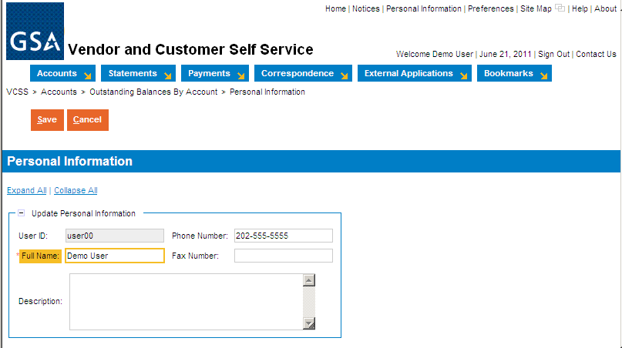
Link Strip (Cont’d)
Personal Information hyperlink
Select the Personal Information hyperlink to maintain your personal information, which is only visible to you.
Review your User ID, Full Name, and Phone/Fax Numbers. Only your Full Name and Phone/Fax Number can be updated if it is not correct, then select the [Save] button.
When you create correspondence or a dispute, your information will be pulled from here.
C7
Notes:
After viewing your notices you’ll be directed to the VCSS home page. You’ll see your Outstanding Balances by Account, the Link Strip, and the Menu Bar.
Let’s go through the different hyperlinks on the link strip.
You can click on the Home page to bring you back to this page.
You can click on Notices to view notices
Next is the Personal Information link which allows you to change things like your name, phone number, fax number, or add a short description.
It is important to note that when you make changes to information, you want to make sure to select the [Save] button.
After clicking save you’ll notice that you’re brought back to your homepage and a message that action was successfully. You can now go back to the personal information and notice that its been changed.

Slide 9
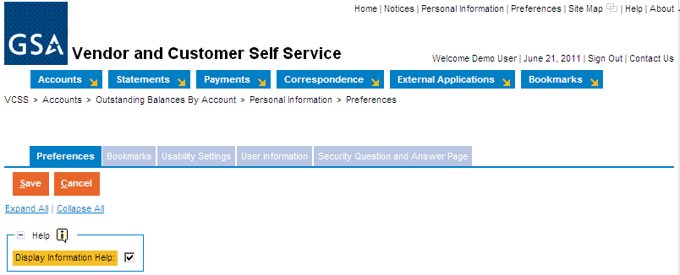
Link Strip (Cont’d)
Preferences hyperlink
Select the Preferences hyperlink to access several settings that you can customize, organized by the following tabs:
Select the Preferences tab to display information help when you hover over links.
Select the Bookmarks tab to organize your bookmarks (reviewed on slide C19).
Select the Usability Settings tab to set up keyboard shortcuts and customize your experience in VCSS (e.g. set the ‘auto tab’ feature so that when you fill out a form in VCSS, your cursor automatically moves to the next field).
Select the User Information tab to reset your password and update your email(your email entered here will be used for correspondence.
C8
Notes:
Next is the preferences link. You’ll see various tabs that you can access.
Access several settings to customize your experience in VCSS.
Select a Preferences tabs to change settings.

Slide 10
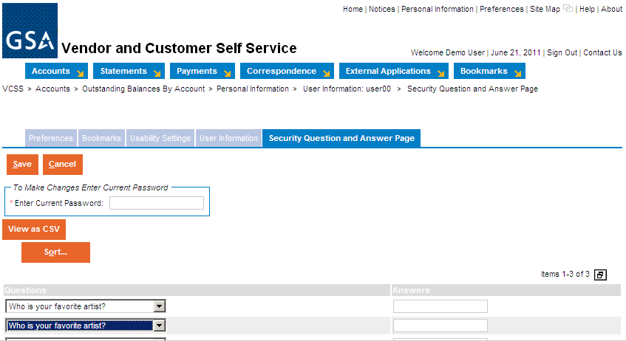
Link Strip (Cont’d)
Preferences hyperlink
Select the Security Question and Answer Page tab to set up security questions and answers as a password retrieval tool. This is not required but is helpful to set up if you would like to be able to recover your password if you forget it.
C9
Notes:
This is a password retrieval tool that is highly recommended that you set up in the case you lose your password.

Slide 11
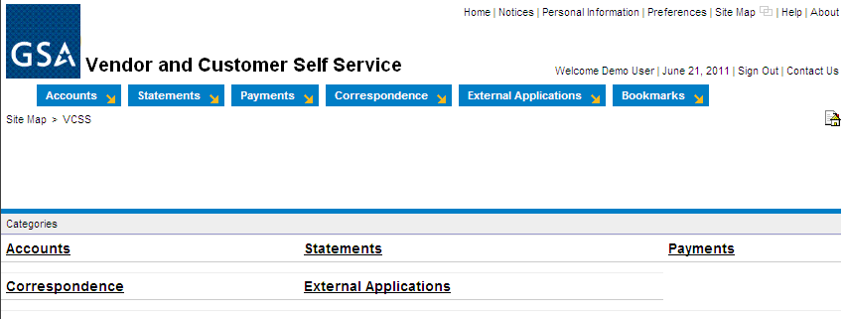
Link Strip (Cont’d)
Site Map hyperlink
Select the Site Map hyperlink to view a list of the menu bar options as clickable hyperlinks.
This is an additional navigation tool to navigate through the hyperlinks as an alternative to using the actual menu bar.
C10

Slide 12
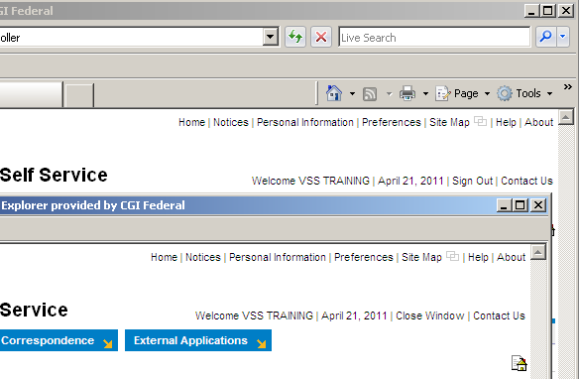
Link Strip (Cont’d)
New Window Icon
There is a square-shaped icon in the link strip called the new window icon (next to the Site Map hyperlink).
Select the new window icon to open a new window of the same session of VCSS, while the current window you are working in also remains open at the same time.
Just like internet explorer, you have the ability to open multiple windows.
Place the windows side by side or switch back and forth between them, giving you the ability to look something up while you are working on something else.
Your original window has the Sign Out hyperlink in the link strip, while your new window has the Close Window hyperlink.
Note: Do not use your browser’s X to close the window. Instead, select the Close Window hyperlink to close the window.
Demo User
Demo User
C11
Notes:
For example, let’s say you are requesting a dispute to send to GSA because you think one of your statements might be in error. While you are going through the dispute process and entering dispute information, you can select the new window icon, open up a new window, and view the actual statement as reference. While you are reviewing the statement, the dispute process window still remains open. When you are finished reviewing the statement, select the Close Window hyperlink in the new window, then go back to the dispute process window that you are working in.
It is important to know that you should not use the Internet Explorer navigation options. Do not use the Back button or use the X to close the window. Instead, you need to use the Close Window hyperlink to close a window.

Slide 13
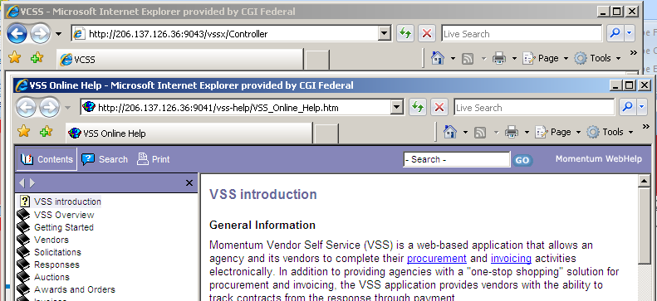
Link Strip (Cont’d)
Help hyperlink
Select the Help hyperlink to open a new window with GSA’s VCSS help documentation, where you can do the following:
Search for help content, organized by topic.
Learn more about VCSS and navigation.
Note: This screenshot is currently what is available in VCSS and will be updated.
C12

Slide 14
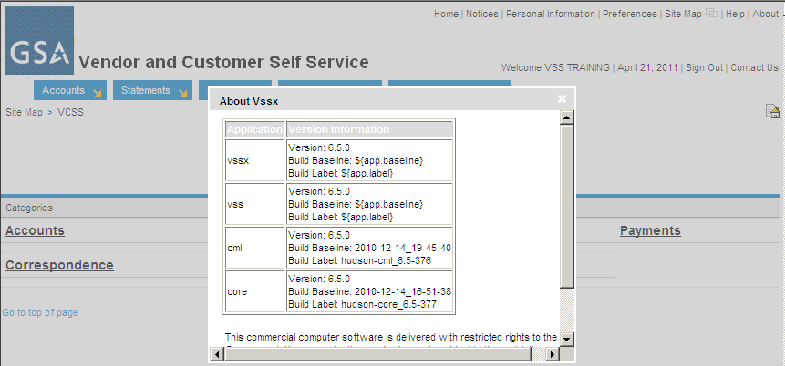
Link Strip (Cont’d)
About hyperlink
Select the About hyperlink to view the VCSS version information.
Demo User
C13

Slide 15

Link Strip (Cont’d)
Sign Out hyperlink
Select the Sign Out hyperlink to exit VCSS.
Upon signing out of VCSS, the VCSS exit page displays a clickable hyperlink to return to the VCSS login page.
Close Window hyperlink
Select the Close Window hyperlink to close the window and return to the previous window.
Displays only on new windows that have been opened.
Demo User
Demo User
C14

Slide 16
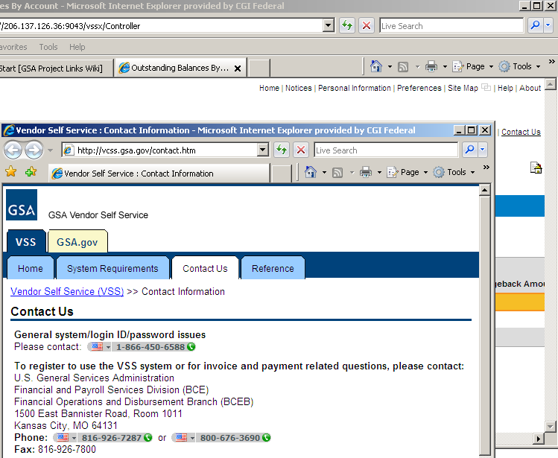
Link Strip (Cont’d)
Contact Us hyperlink
Select the Contact Us hyperlink to access GSA contact information for VCSS.
Note: The GSA Contact Us page will display the appropriate GSA contact information for both vendors and customers.
C15

Slide 17
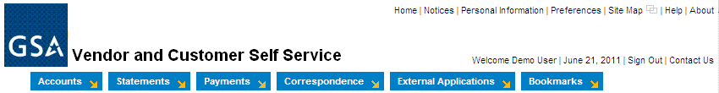
Menu Bar
Use the menu bar to navigate through your account and access account information.
Each menu item contains a drop-down list of menu options, grouped by function.
These menu items will be covered in separate sections of this presentation, as indicated below.
Accounts (segment 4)
Statements (segment 5)
Payments (segment 6)
Correspondence (segment 7)
External Applications (segment 8)
C16
Notes:
Here is a list of the menu bar options that display in the menu bar. This is how you navigate through your account and account information. This menu bar is static and remains on the home page of VCSS.
We are going to walk through each of these in separate sections of this training, after we finish going through basic navigation.

Slide 18
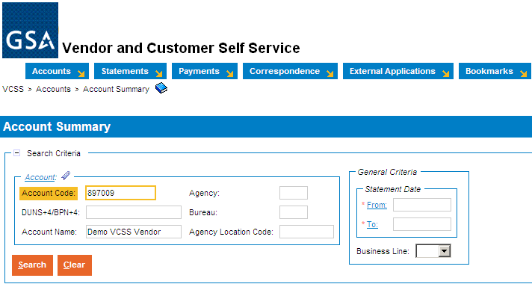
Breadcrumbs
Breadcrumbs show the path to the current page you are on.
Breadcrumbs include hyperlinks that represent the most likely path you might have followed to navigate to the current page you are on.
Located at the top of the page, below the menu bar, on various pages throughout VCSS.
Select a hyperlink in the breadcrumbs to return to a previous page, since you cannot use the back button in your browser.
For example, if you are on the Account Summary page, the breadcrumbs display showing the most common path to navigate to the Account Summary page. In this case, the Account Summary page is accessed from the Accounts menu.
C17
Notes:
For example, let’s say you selected the Accounts menu bar, then the Account Summary option. The breadcrumbs trail now shows you the Account Summary hyperlink which is the page you are now on. Since the Account Summary option is within the Accounts menu bar, the Accounts hyperlink displays too.

Slide 19

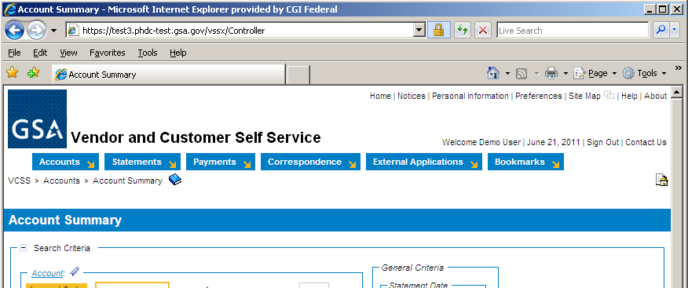
Breadcrumbs (Cont’d)
Internet Explorer Browser Navigation
To navigate within VCSS, do not use your browser’s navigational tools, which includes the back button and the X used to close the window.
If you use your browser’s navigational tools accidentally, you will be signed out of VCSS and risk losing your work.
Instead, use the VCSS navigation tools, which are the breadcrumbs, menu bar, and link strip.
C18
Notes:
Point out the back button and the X in Internet Explorer to point out that you should not use Internet Explorer navigational options (i.e. Back button) to navigate within VCSS.

Slide 20
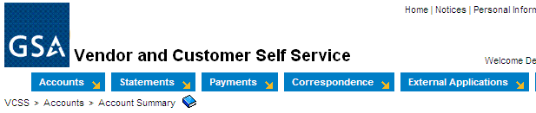
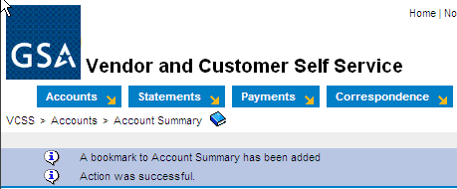
Bookmarks
If you access a specific page frequently in VCSS (e.g. the Account Summary page), then add that page as a bookmark to access quickly at a later time.
If the page can be added as a bookmark, then the bookmark icon is located to the right of the breadcrumbs.
Bookmarks in VCSS work similarly to favorites in internet explorer.
Add a Bookmark
To add a bookmark, select the bookmark icon on the page you want to add as a bookmark.
A system message displays confirming the bookmark has been added.
C19
Notes:
If you access a specific page frequently in VCSS, (e.g. the account summary page), then add that page as a bookmark to access quickly a later time.
Bookmarks in VCSS work similarly to adding a favorite in Internet Explorer.

Slide 21
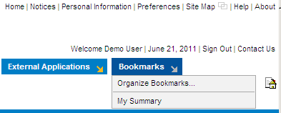
Bookmarks (Cont’d)
Access a Saved Bookmark
Once you add a page as a bookmark, the Bookmarks menu item displays in the menu bar.
If you have not added a bookmark, the Bookmarks menu does not display.
To access the saved bookmark, from the menu bar select Bookmarks > [Name of bookmark].
C20
Notes:
Your bookmarks remain from one login session to the next.

Slide 22

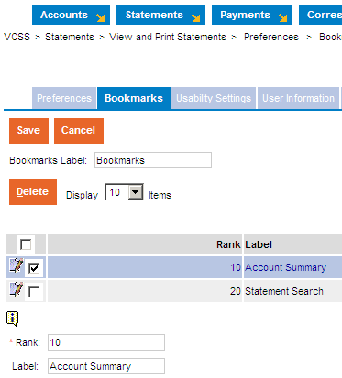
Bookmarks (Cont’d)
Organize Saved Bookmarks
Once you have added a few bookmarks, you can organize your bookmarks from the menu bar by selecting Bookmarks > Organize Bookmarks.
Bookmarks display in the Bookmarks menu in the order in which they were added. To re-order bookmarks, select a bookmark and update the Rank field.
To re-name a bookmark, select the bookmark and update the Label field.
To remove a bookmark, select the bookmark and select the [Delete] button.
To save updates, select the [Save] button.
C21
Notes:
Once you have added a bookmark, you can organize your bookmarks by changing the name of the bookmark. If you have more than one Bookmark, you can re-order how the bookmarks display in the Bookmarks menu.

Slide 23
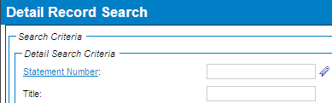
Hyperlinks
Blue underlined hyperlinks that list the name of a field, display on many pages.
Select the hyperlink to access a search page to search for values to enter in that specific field.
This can be helpful if you cannot remember a value to enter in a field. Instead, you can select the field’s hyperlink and then search for values. The hyperlinks work as a lookup to find the value you need to enter in that field.
For example, if you need to enter a statement number and you cannot remember the specific statement number to enter, select the Statement Number hyperlink. You are then taken to a search page to search for statement numbers. Once you find the statement number you need, select the statement number to enter in the Statement Number field.
C22
Notes:
Throughout VCSS, you come across blue underlined text, which is a clickable hyperlink. Many of these hyperlinks are the label next to a specific field, and when you select the hyperlink, you access a search page to search for values that can be used in that specific field.
For example, if you need to enter a specific statement number in VCSS, the Statement Number field is a blue hyperlink, meaning you can select it. When you select the Statement Number hyperlink, you access a search page to search for statement numbers associated with your account.
This can be helpful if you cannot remember specific values to put in a field. Instead, you can select the hyperlink to search for a particular value to put in the field.
We can review an example of selecting a hyperlink later in the training.

Slide 24
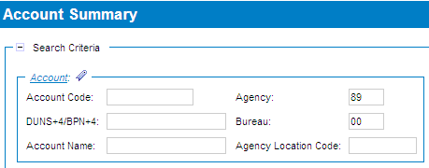
Favorites
Favorites are frequently used values that can be saved.
Favorites are a feature of VCSS that will be available in a future release.
If you use a value frequently, then you can designate it as a favorite.
Favorites can be added to fields that include the favorites icon next to it, which looks like a small clothes-pin. Favorites are added by you only and remain from one login session to the next.
For example, if you have access to more than one account, designate a specific account as a favorite, by selecting the favorites icon and adding your account as a favorite.
C23
Notes:
For example, let’s say you need to search for information on one of your accounts frequently. If you add the account code as a favorite, then you can select it from the list of favorites, instead of typing the account code in by memory, and it populates the saved value in the account code field. These favorites that you add will remain saved from one login session to the next. They can only be removed by you, using the trashcan icon.
Favorites will be available in a future release.

Slide 25
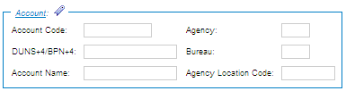

Favorites (Cont’d)
Add a Favorite
Select the favorites icon next to the field.
In the favorites pop-up window, select the Search hyperlink to search for field values (in this example search for account values).
C24
Notes:
Any field with a favorites icon next to it, means that you can add favorite values to be used in this field on different pages within VCSS.
Select the favorites icon next to a field to view the favorites pop-up window.
The favorites pop-up window will display any favorite values you have already added previously. Since we have not added any favorites yet, this favorites pop-up window is empty. There is always a Search hyperlink available to search for new values to be added as favorites.

Slide 26
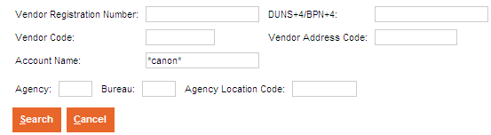
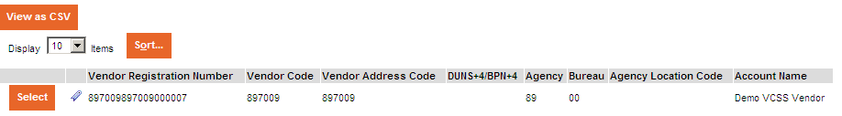
Favorites (Cont’d)
Add a Favorite
On the search page, enter search criteria to search for valid values and then select the [Search] button.
In the search results, select a record to add the value as a favorite by selecting the favorites icon next to the record.
You can add multiple favorites.
C25
Notes:
After selecting the Search hyperlink in a favorites pop-up window, you will be taken to a search page to search for values that can be used in the field that you selected the favorites icon next to.
After running your search for favorite values, in the search results the values that met your search criteria display. Select the favorites icon next to a value that you would like to have added as a favorite for the field. Upon selecting the favorites icon, the search page refreshes and the value is added to the fields’ favorites pop-up window.

Slide 27
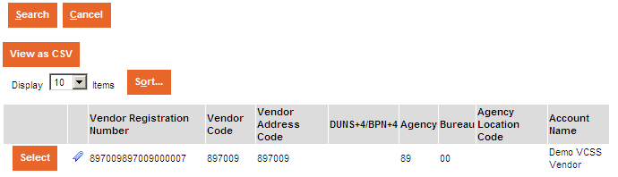
Favorites (Cont’d)
Add a Favorite
Once you have added favorites for a field, to return to your previous page you can do either of the following:
Click the [Select] button, which fills in the field with the selected record information, or,
Click the [Cancel] button, which does not fill in the field with the selected record information.
C26
Notes:
To leave the search page and return to the page with the field where you selected the favorites icon next to, you have two options.

Slide 28
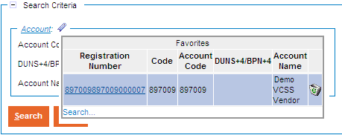
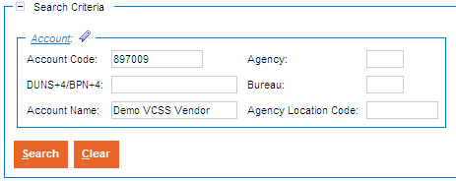
Favorites (Cont’d)
Access a Saved Favorite
Select the favorites icon next to the field that you added favorites for.
The favorites pop-up window displays with the favorite values you added.
Simply select the favorite record to populate the field with the favorite record value.
The field is now populated with the favorite record values.
In the example below, the account we previously added as a favorite is now populated in the appropriate account fields.
C27
Notes:
When you select the favorites icon next to the field you added the favorites for, the favorites pop-up window displays with the favorites value that you added.
In most instances, when this field displays in other pages of VCSS, select the favorites icon next to the field and you will see your favorite values display.

Slide 29
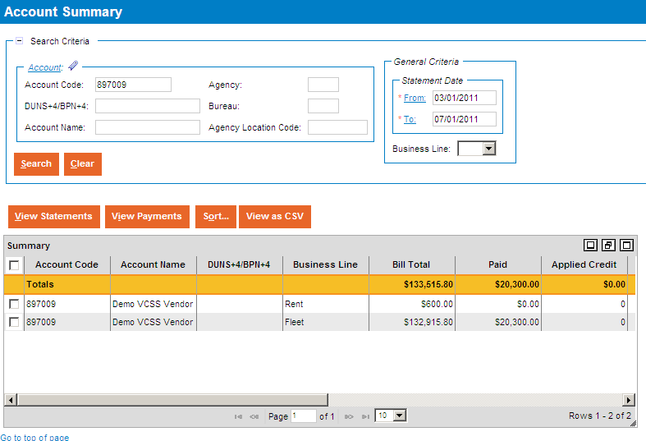
Standard Page Layout
Below is an example of a standard page layout for most pages in VCSS. Not every page follows this exact layout.
The top portion of the page has an area referred to as “search criteria”.
The bottom portion of the page has an area referred to as “search results”.
search criteria
search results
C28

Slide 30
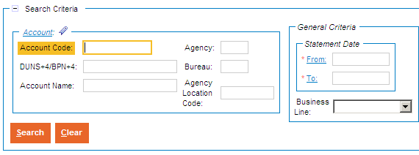
Standard Page Layout (Cont’d)
Search Criteria
In the search criteria area of the page, enter values in the search criteria fields to filter the search results that return, and locate the information you need.
If there are many records for the system to filter through, entering more search criteria can shorten the time it takes for the system to return records.
Most search criteria fields that are required will be marked with a red asterisk (*).
Use the wildcard character (*) to ease searching (this is covered on the next slide).
When you finish entering search criteria, select the [Search] button to run the search.
C29

Slide 31
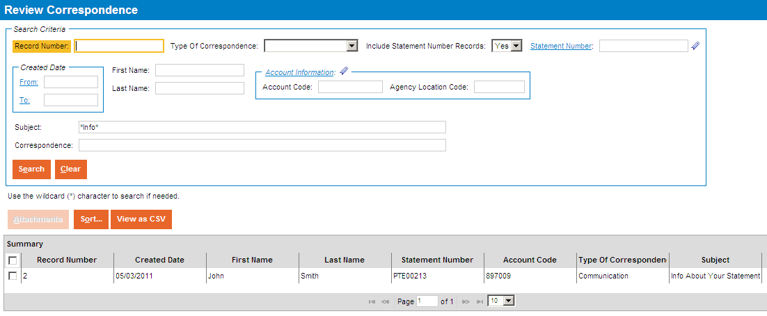
Standard Page Layout (Cont’d)
Wildcard (*)
The wildcard character can be optionally used in search criteria fields and substitutes a character or group of characters.
You can add the wildcard at the beginning, middle, or end of a value. You can also add more than one wildcard character in a search field.
For example, if you want to search for a correspondence that has the subject line “Info about your statement”, then enter the following in the subject search criteria field:
Wildcard at the beginning (*info), middle (info*statement), or end (info*).
Add more than one wildcard (*info*).
C30
Notes:
We will run through an example using the wildcard (*) character, which will really help with searching.
You can use more than one wildcard (*) character in a search field.

Slide 32
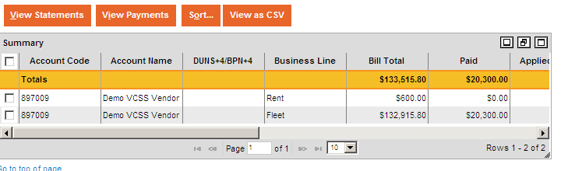
Standard Page Layout (Cont’d)
Search Results
The search results area of the page consists of rows of data called “records” that met the search criteria.
In some cases, a “Totals” row displays that gives you the total amount of that column (the Totals row displays total amounts for all records that meet the criteria, not just those being displayed).
Search results can display up to 1,000 records at a time.
Here are some options that you have to change how your search results display:
Minimize and maximize the search results list.
Use the scrollbars to scroll through the records.
Adjust column width by dragging the vertical column lines.
Change the number of records that display at once (10, 20, 50, 100, ALL).
Change the size of the search results by using the drag-able corner in the bottom right.
C31
Notes:
You can always review search results in the search results area, with many options to change your view of the search results.

Slide 33
Standard Page Layout (Cont’d)
Search Results
In the search results, there are action buttons that display directly above the records. These action buttons tell you what you can do with the records.
The [Sort] button is a common action button used to sort all the records in the search results by column heading.
The [View as CSV] button is also a common action button used to export the records in the search results to a Comma Separated Value (CSV) file.
In addition, when you select a record in the search results, there may be action buttons that become available and are specific to the record selected.
For example, the [View Statements] and [View Payments] buttons are grayed out until you select a record. When you select a record, you can view statements and payments for that record.
C32
Notes:
When you select a record in the search results, there will be action buttons available to perform for that record selected.
Two common action buttons you will see are the [Sort] button and the [View as CSV] buttons.

Slide 34
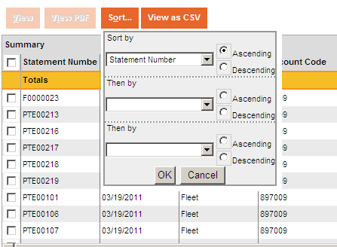
Standard Page Layout (Cont’d)
Sort Records
If there is a [Sort] button in the search results, then you have the option to sort the records by up to three columns.
You do not need to select a specific record in order to select the [Sort] button, since all records are sorted.
Select the [Sort] button.
Select a Sort by column, then the Ascending or Descending radio button.
Select the [OK] button to sort the records.
You can also sort individual columns by selecting a column heading to sort in ascending order. Select the column heading a second time to sort in descending order.
C33
Notes:
If there are multiple records, you can sort them by a specific column heading in ascending or descending order.
This can be really helpful there are many records and you want to specify the particular values you want to see.

Slide 35
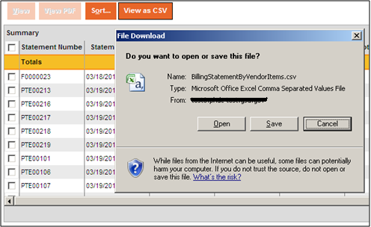
Standard Page Layout (Cont’d)
Export Records
If there is a [View as CSV] button in the search results, then you can export the records to a Comma Separated Value (CSV) file format, which can be opened in a Microsoft Excel spreadsheet.
You do not need to select a specific record in order to select the [View as CSV] button, since all records are exported.
Select the [View as CSV] button.
In the file download pop-up window, select the [Open] button to open the CSV file.
Note: Depending on your browser settings, you might need to allow pop-ups to use this view as CSV feature.
C34
Notes:
If there are multiple records, you can export the records to a CSV file that can be opened in an Excel spreadsheet.

Slide 36
References
Return to the GSA VCSS Launch Page to access other segments of the VCSS presentation: http://vcss.gsa.gov.
Segment 1: Introduction
Segment 2: VCSS Account Registration & Requesting Access
Segment 3: Basic Navigation
Segment 4: Account Information
Segment 5: Statement and Dispute Information
Segment 6: Customer Payment Information
Segment 7: Correspondence Information
Segment 8: External Applications Information
C35
Notes:
This concludes segment 3 of the VCSS presentation.

